Slide 1
세상 모든 자연과 통하다
GLOBAL ECO THE SAEM
Gold Snail Bar

Slide 2
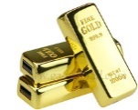
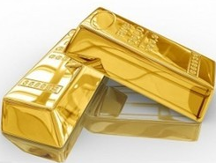
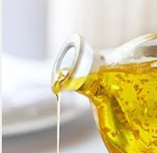
Profile of Gold Snail Bar
Product Name | Gold Snail Bar
Concept | Feel the Spa-quality, Luxurious Pamper everyday in your own bathroom . Cleansing bar with 24K Gold, Concentrated snail mucin filtrate, Golden olive oil and natural plant enzyme. Packaging design inspired by the real gold.
TARGET | Perfect for a small gift. Age over 35 who are concerned about dehydration and aging.
Price | Korean Retail Selling Price (KRSP) : ₩ 6,000 / 160 g
Luxurious Cleansing soap bar
Ingredients & Features
How To Use | Use for daily cleansing. Rub the bar with your wet hands to produce the lather, then wash off with lukewarm water.
24K Gold
Snail Mucin
Golden Olive Oil
99.9% pure gold
⇒ Increase skin’s own immunity, Stimulates circulation, Increase skin elasticity.
Snail mucin is rich in collagen elastin.
⇒ Increases firmness, hydration level.
Extra virgin golden olive oil is enriched with polyphenols which has many skin care benefits: Anti-inflammation, Increase of cell renewal, Skin-calming.
RESULT
Natural plant enzyme (NOT synthetic)
Skin feels soft and comfortable right after cleansing.
Deeply cleansed
Strengthens skin’s own immunity
Helps with skin’s firmness
Gentle but very effective in forming lather which penetrates through the pores and takes away the dead skin cells and other impurities.

